Slide 1

Wave energy converter power increase through active control: Fixed Gains
Student: Carl Selig
Supervisor: Dr. Andrew Hillis
Assessor: Joseph Flynn

Slide 2
Background
Begun by Peter Salter in 1973 during the oil crisis.
A promising renewable energy source with numerous advantages:
Constant load / predictable
Widely available
Easy to install
There are also problems to overcome:
Only directly beneficial to coastal regions
Vulnerable to rough weather
Low lifetime yield compared to embodied energy

Slide 3
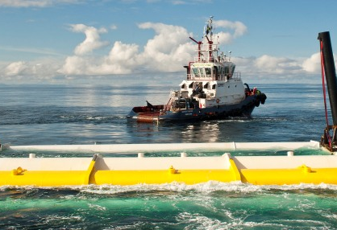
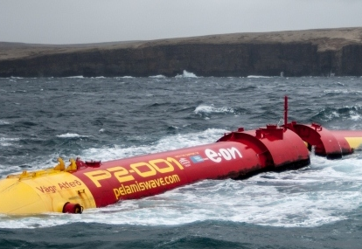
Background
Many previous attempts; only two products brought to market
Marine Power Systems has proposed the WaveSub device.

Slide 4
Literature
Fusco & Ringwood 2013: A simple and effective real-time controller for Wave Energy Converters.
Underpins this project. Conclusive findings in a 1-D scenario.
Well-written, thorough, highly regarded.
EWTEC 2019 conference proceedings:
The state of the art for Wave Power.
Variable in quality and applicability.
Includes supervisor’s work on LQR control and State-Space models.
Salter: “Wave Energy: Nostalgic Ramblings, future hopes, and Heretical suggestions.”
Comprehensive history overview despite amusing title.
A little informal but nonetheless rigorous.

Slide 5
Aims and Objectives
AIM: To answer the research questions:
Does the drift problem occur if Ringwood’s work is adapted for planar motion?
If so, can the drift problem be resolved by other means?
What is the power gain compared to an optimally tuned, passively damped system?
Objectives:
Reproduce Ringwood’s work for a planar device for simple sea waves.
As above but under Kinematic conditions and irregular sea waves.
Determine whether or not the drift problem reoccurs.
Attempt to solve the drift problem using understanding of control theory, Rigid Body Motion, and the system Kinematics.
Alternatively compensate for the drift with an additional position control loop if an analytic solution cannot be found.
Produce Final Report

Slide 6
Methodology and Deliverables
Methodology
Deliverables
Positivist philosophy
Pure simulation
WecSim Simulink environment
Recorded waves
Comparison based on energy capture
Final Simulink Model
Project code repo
Project report

Slide 7
Progress and Preliminary results
Installed and ran the WecSim environment
Implemented State-Space models of the Plant
Implemented the IMC loop
Calculated reference velocity for simple waves from amplitude response of radiation force TFs
Created a robust inverse of the State Space model using the Massey-Sain algorithm
Results: No Drift problem yet. Perfect tracking.

Slide 8
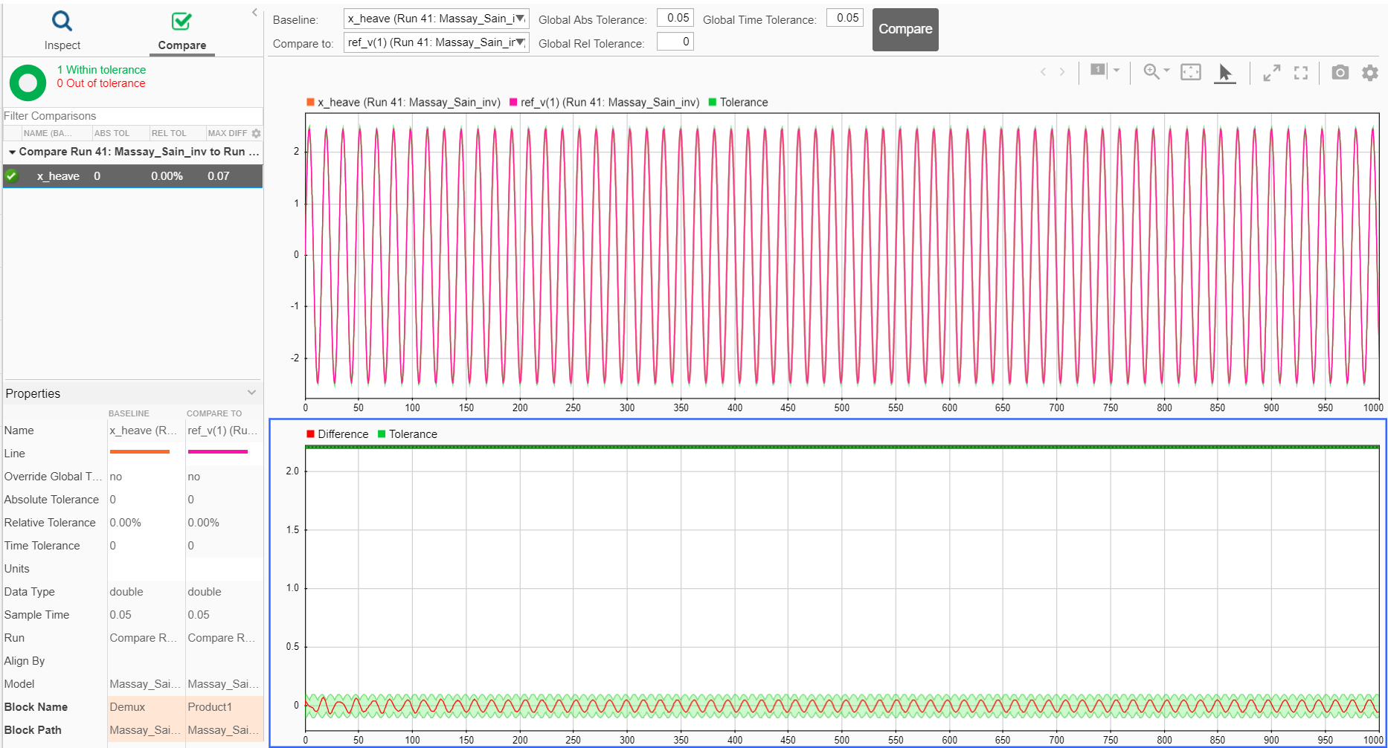

Slide 9
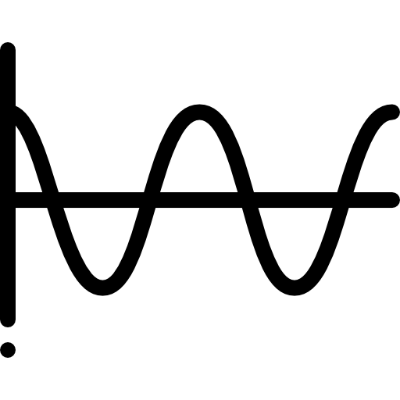




Timeline
Simple Sea States
Drift Problem Investigation
Report
Mar 15th
Apr 12th
Mar 1st
Apr 5th
Apr 28th
Irregular Sea States
Final model and Results

Slide 10
References
Makeagif, 2020, Salter Duck [Online] Available at: https://makeagif.com/gif/salter-duck-dB3qCf [Accessed 5 March 2020] [Slide 2]
The European Marine Energy Center Ltd., 2019. Wave Clients. [Online] Available at: http://www.emec.org.uk/about-us/wave-clients/ [Accessed 11 November 2019]. [Slide 3]
Marine Power Systems, 2019. Wave Sub. [Online] Available at: https://marinepowersystems.co.uk/wavesub/ [Accessed 24 November 2019]. [Slide 3]
Fusco, F. & Ringwood, J., 2013. A Simple and Effective Real-Time controller for Wave Energy Converters. IEEE Transactions on Sustainable Energy, January, 4(1), pp. 21-30 [Slide 4]
Technical Committee of the European Wave and Tidal Energy Conference, 2019, Proceedings of the European wave and Tidal Energy Conference. [Slide 4]
Salter, S., 2016. Wave energy: Nostalgic Ramblings, future hopes and heretical suggestions. J. Ocean Eng. Mar. Energy, 2(4), pp. 399-428. [Slide 4]
Flaticon, 2020. Icons by Freepik. [Online] Available at: https://support.flaticon.com/hc/en-us [Accessed 5 March 2020] [Slide 8]

Slide 11
Thank you for listening
Any questions?

Slide 12
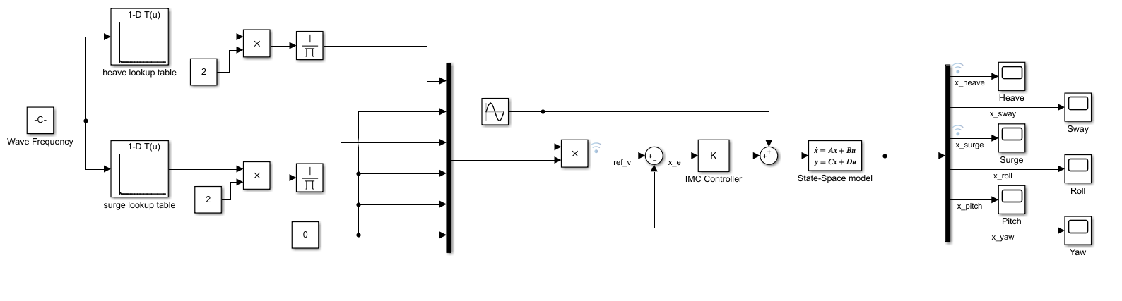
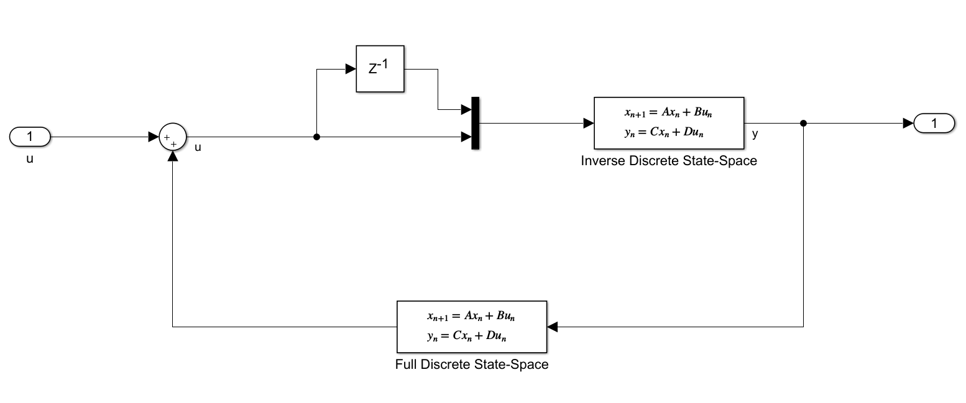
IMC Control loop

Slide 13
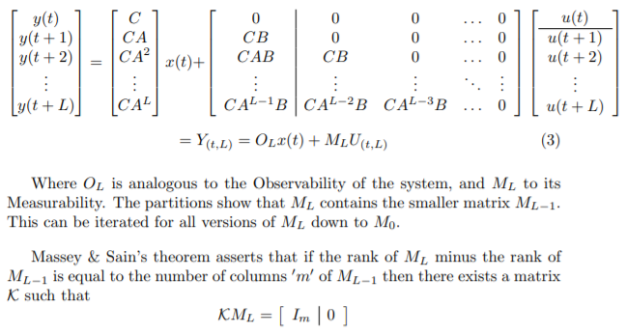
Massey-Sain Algorithm

